Slide 1
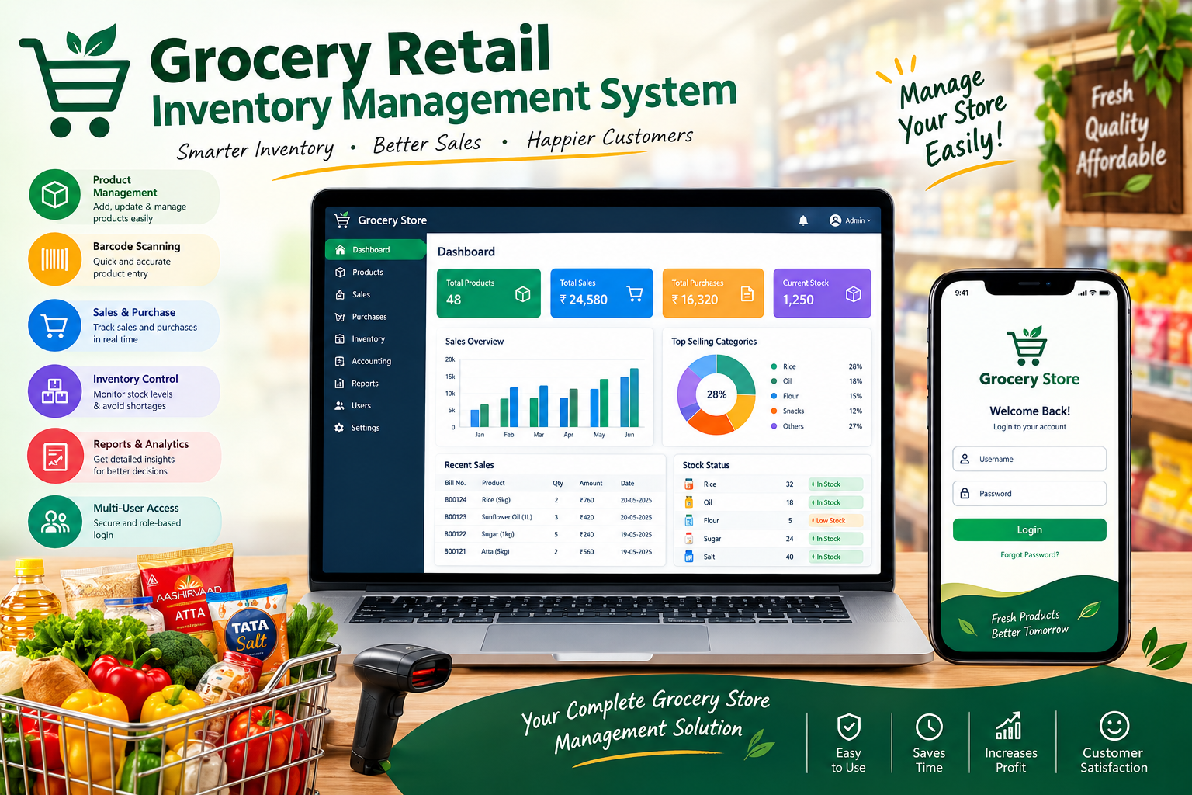

Slide 2
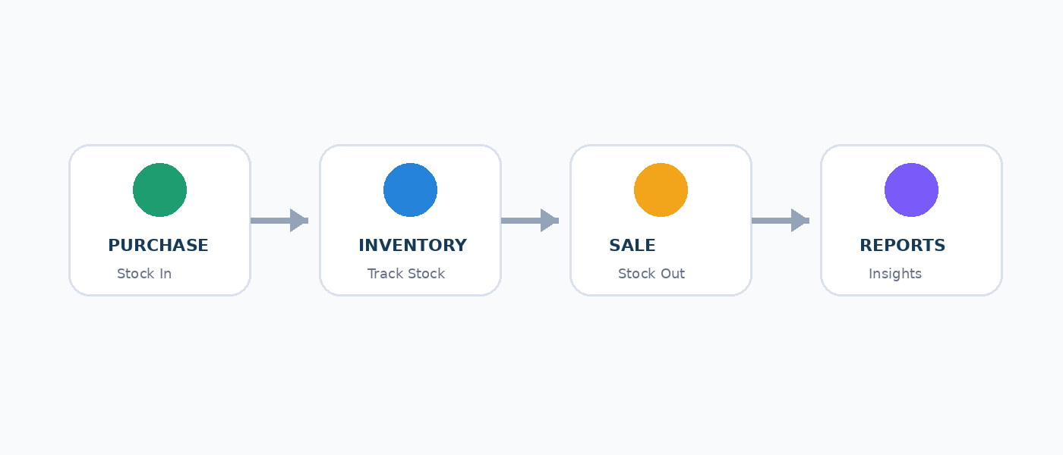
1. Project Overview
A practical system for a home-grocery retail shop
Centralizes products, purchases, sales, inventory, suppliers, customers and expenses.
Automatically updates stock from transactions.
Provides low-stock and expiry alerts.
Helps the shop owner make faster, data-based decisions.
2

Slide 3
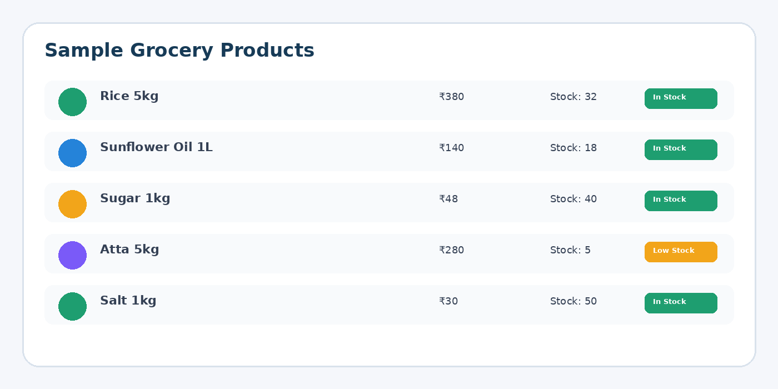
2. Problem Statement
Manual stock records are time-consuming.
Stock shortages may be noticed too late.
Purchases and sales can be difficult to reconcile.
Expiry dates and supplier details may be scattered.
A single digital system can reduce these problems.
3

Slide 4
3. Objectives
01
02
03
Manage Products
Track Inventory
Record Sales
04
05
06
Manage Purchases
Monitor Expiry
Generate Reports
4

Slide 5
4. Main Modules
Login & Authentication
Dashboard
Products & Categories
Purchases
Sales / Billing
Inventory & Stock Transactions
Suppliers & Customers
Expenses
Reports & Settings
5

Slide 6
5. Grocery Product Management
Product name, category and brand
Barcode / SKU
Purchase and selling price
Current and minimum stock
Unit: kg, gram, litre, ml, packet, box, bottle, piece
Batch number and expiry date
Supplier and product status
6

Slide 7
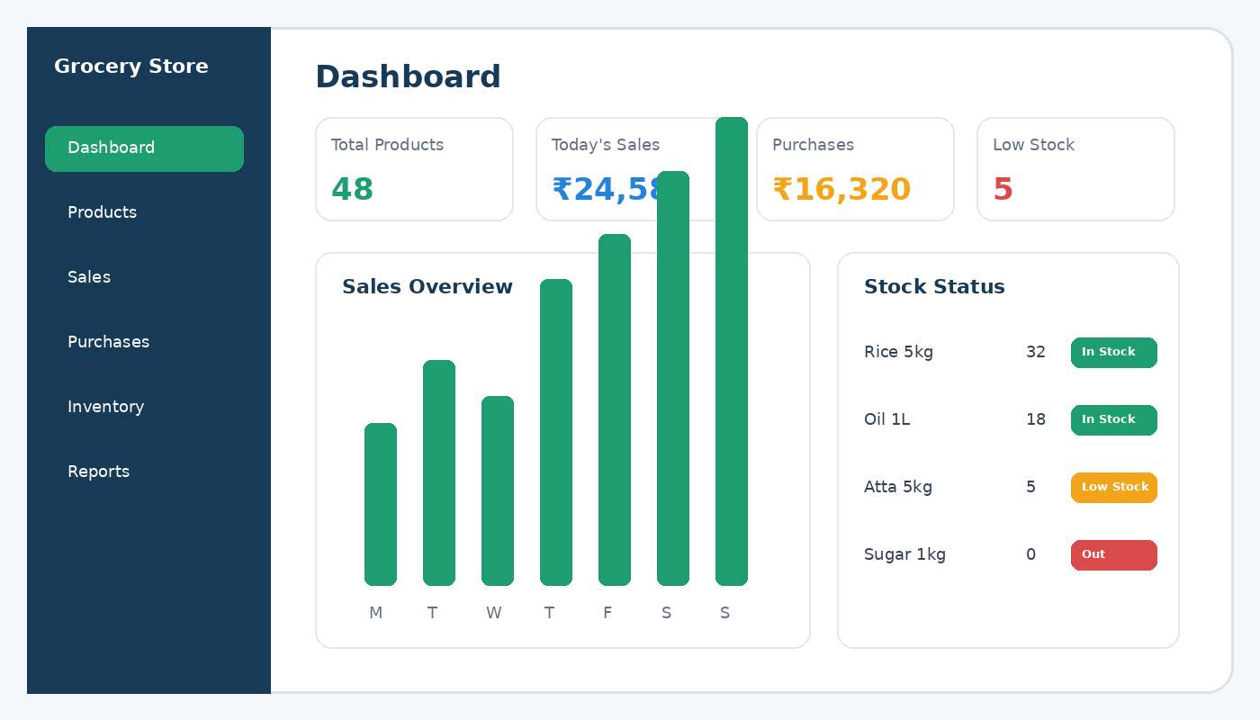
6. Inventory Management
Transaction-based stock control
Purchase → Stock increases
Sale → Stock decreases
Low Stock when current stock ≤ minimum level
Out of Stock when quantity = 0
Every stock change creates an inventory transaction
Negative inventory is prevented
7

Slide 8
7. Sales & Billing
POS-style product search and billing
Quantity, selling price, discount and GST/tax
Cash, UPI, Card and Other payment methods
Checks available stock before sale
Automatically reduces inventory
Printable invoice with sale details
8

Slide 9
8. Purchases & Suppliers
Supplier, invoice number and purchase date
Multiple products per purchase invoice
Quantity, purchase price, tax and discount
Payment status and notes
Completed purchases automatically increase inventory
Supplier purchase history
9

Slide 10
9. Expiry & Stock Alerts
Expired
Expiring ≤ 7 days
Expiring ≤ 30 days
Low Stock
Out of Stock
10

Slide 11
10. Reports & Analytics
Daily and monthly sales
Purchase report
Inventory and low-stock report
Expiry report
Expense report
Product sales report
Estimated gross and net profit
Date filters and export/print options
11

Slide 12
11. Technology Used
Frontend
React + TypeScript
UI
Tailwind CSS
Database
Supabase PostgreSQL
Authentication
Supabase Auth
Development
Lovable
Design
Responsive Web UI
12

Slide 13
12. Sample Grocery Products
Sona Masoori Rice – 5 kg
Fortune Sunflower Oil – 1 Litre
Sugar – 1 kg
Aashirvaad Atta – 5 kg
Tata Salt – 1 kg
Other categories: pulses, spices, biscuits, beverages, dairy, cleaning and personal care
13

Slide 14
13. Benefits
Saves time in daily inventory management.
Improves visibility of available stock.
Helps identify products that need restocking.
Reduces manual calculation errors.
Makes sales, purchase and expense records easier to maintain.
Provides useful information for shop management.
14

Slide 15
14. Future Enhancements
Barcode scanner integration
Advanced GST invoicing
Supplier payment tracking
Customer credit management
WhatsApp/SMS notifications
Cloud backup and restore
Advanced business analytics
Multi-user roles and permissions
15

Slide 16
15. Conclusion
The system provides a centralized solution for daily grocery shop operations.
Products, purchases, sales and inventory are connected through transaction-based stock management.
The project can be expanded with advanced billing, analytics and business features.
It is designed to be practical for real-world retail use.
16

Slide 17
Thank You • Questions & Discussion
17

